Slide 1
A simulation of public pension plans: methods and applications
David Matkin, Gang Chen, Hao Sun
Rockefeller School of Public Affairs and Policy
University at Albany – SUNY

Slide 2
Background
In 2016, we found (Chen & Matkin, 2016):
  Pension costs and liabilities are sensitive to actuarial assumptions. These assumptions include discount rate, salary growth rate, mortality rates, and cost methods.
  There are interactive effects with a plan’s characteristics, such as benefit provisions and age distribution.
Based on the research, we build a more comprehensive simulation model to calculate pension costs and liabilities.
  A database of multipliers for pension costs and liabilities
  A R package that allows researchers and plan administrators to calculate pension costs and liabilities.
  Funded by Sandell Grant through Center for Retirement Research at Boston College

Slide 3
Other prior research
Efforts to standardize pension costs and liabilities
  Chaney, Copely, and Stone (2002): Rule of thumb
  Eaton and Nofsinger (2004): Linear prediction
  Moody’s (2013) : Adjusted Pension Liability
  Milliman (2014): Recalibrated liability
Efforts to use simulation in pension research
  Kingsland and Gruber (1982): impact of investment policies
  Fehr, Kallweit and Kindermann (2012): Impact of increasing retirement age
  TAXSIM (NBER 1993): Impact of tax policy changes
Efforts to examine the impact of actuarial assumptions on pension costs and liabilities (Dulebohn 1995; Eaton and Nofsinger 2004; Mitchell and Smith 1994; Mitchell and Hsin 1997; Rich and Zhang 2014)

Slide 4
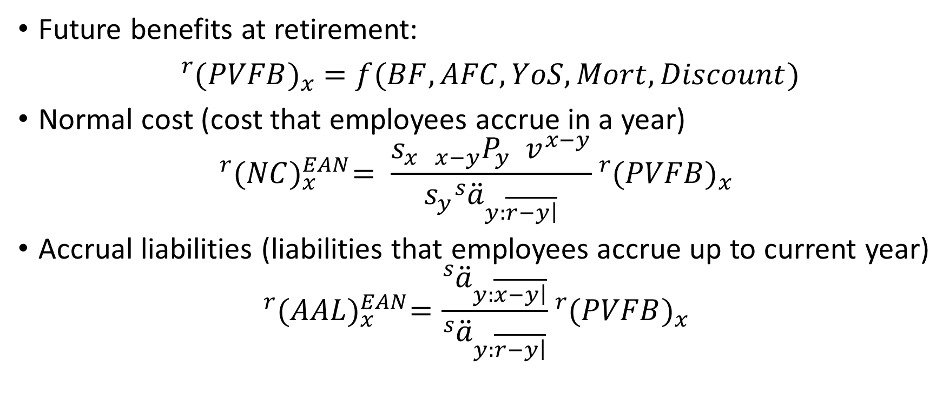
The simulation model
Future benefits at retirement:
${}_{ }^{r}{{(PVFB)}_{x} =f(BF, AFC, YoS, Mort, Discount) }$
Normal cost (cost that employees accrue in a year)
$${}_{ }^{r}{{(NC)}_{x}^{EAN}}= \frac{s_{x} {{}_{x−y}^{ }P}_{y}^{ } v^{x−y}}{s_{y}{{}_{ }^{s}{\ddot{a}}}_{y:\overline{\left.r−y\right|}}^{ }}{}_{ }^{r}{{(PVFB)}_{x}}$$
Accrual liabilities (liabilities that employees accrue up to current year)
$${}_{ }^{r}{{(AAL)}_{x}^{EAN}}=\frac{{}_{ }^{s}{{\ddot{a}}_{y:\overline{\left.x−y\right|}}^{ }}}{{}_{ }^{s}{{\ddot{a}}_{y:\overline{\left.r−y\right|}}^{ }}}{}_{ }^{r}{{(PVFB)}_{x}}$$

Slide 5
Inputs and outputs
Inputs:
  Actuarial assumptions: discount rate, inflation rate, salary growth rate, mortality tables, cost methods
  Plan characteristics: entry age, current age, retirement age
  Benefit provisions: benefit formula, vesting period, cost-of-living adjustments
Outputs:
  Normal cost for each employee
  Accrual liability for each employee
  (with population) costs and labilities for a plan
  (with asset level) funding ratio
  (with funding policy) required contribution (ARC)

Slide 6
Applications (1): examine the impact of policy changes on pension liabilities

Slide 7
Applications (1): examine the impact of policy changes on pension liabilities

Slide 8
Application (2): Examine the life cycle effect of policy change on one employee

Slide 9
Application (2): Examine the life cycle effect of policy change on one employee

Slide 10
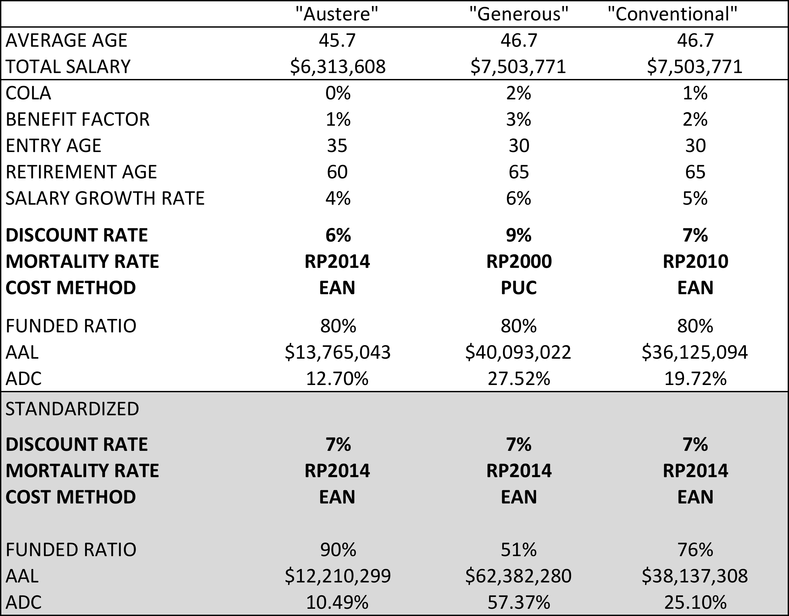
Applications (3): Standardize the calculation of financial conditions across systems

Slide 11
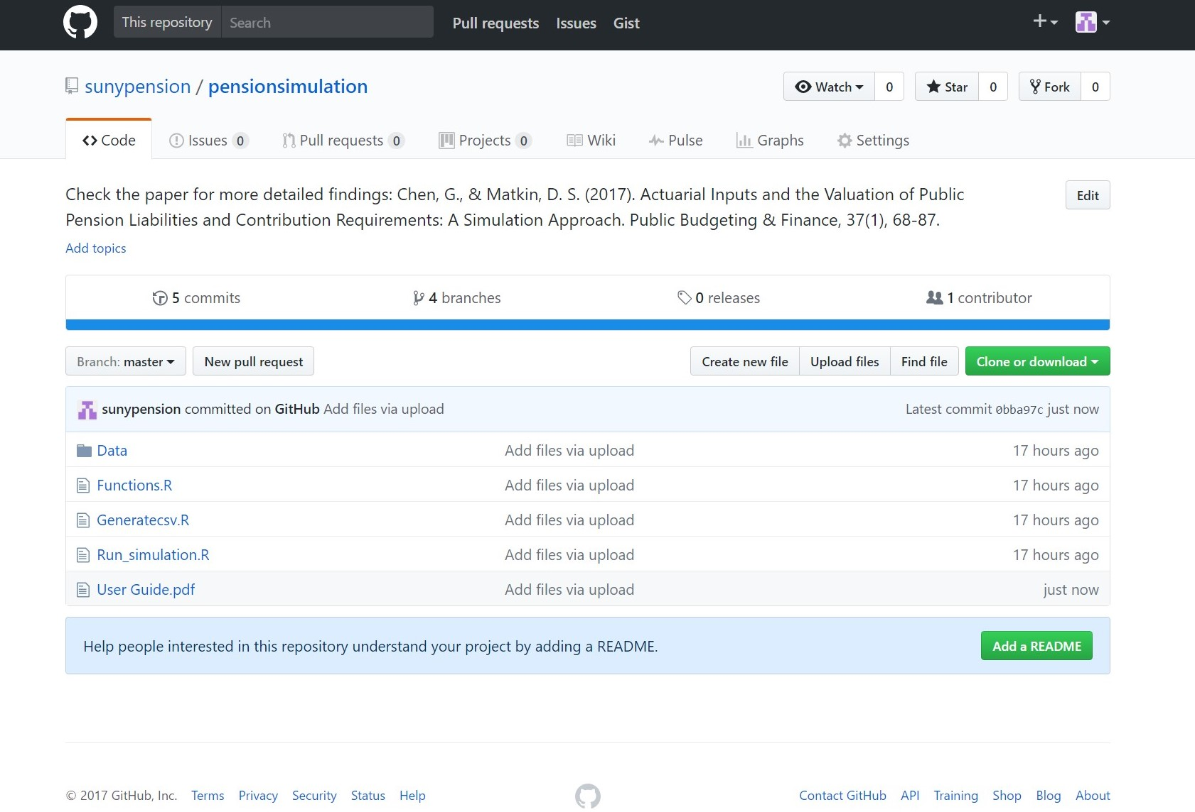
User Guide (GitHub screenshot)
Place to download: https://github.com/sunypension/pensionsimulation
End product of this project:
1. Detailed User Guide
2. R codes to create to simulate all kinds of normal cost and actuarial accrued liability based upon sixteen different possible actuarial assumptions;
3. Seven comma-separated values (CSV) files: six separate data set, based upon two calculation methods and three mortality table choices, and a combined data set which consists of the six data set.
What are needed to replicate or create your own data:
1. Softwares and pacages: R or RStudio with additional eight R packages
2. Run Simulation.R with keeping or adjusting the sixteen actuarial assumptions
3. Functions.R includes all related calculation from Pension Mathematics with Numerical Illustrations (1993).
4. Generatecsv.R, for creating the final seven CSV files

Slide 12
Next steps:
More simulations:
  Asset volatility
  Ancillary benefits
  Demographic changes
  Pay-as-you-go pension schemes
More applications
  Intergenerational equity
  Real pension plans
  Impacts of changing regulations
  Impacts of changing benefit policy or contribution policy

